Slide 1
Game Pass - your game, your way
A privacy-preserving solution for single game purchases

Slide 2
Problem:
Traditional game passes require users to commit to a monthly or season-long subscription, even if they only want to watch a few games
This can be expensive and inconvenient for users who only want to watch occasional games
Additionally, there are privacy concerns associated with using traditional game passes, as users are required to provide personal information and financial data.

Slide 3
Solution:
Game Pass Lite is a privacy-preserving solution for single game purchases. It uses zero-knowledge proofs (ZKPs) to allow users to prove that they are authorized to play a particular game without revealing their identity or payment information

Slide 4
How it works:
The user selects the NBA game that they want to watch and pays XYZ for the game using cryptocurrency.
XYZ generates a ZKP that proves that the user has paid for the game and that XYZ has purchased a season pass to the NBA.
XYZ sends the ZKP to the user.
The user verifies the ZKP.
XYZ authenticates itself to the NBA using its own credentials.
XYZ fills out their log in credentials in user’s website automatically.
XYZ streams the game to the user.
After the game is over, XYZ logs out the credentials automatically.

Slide 5
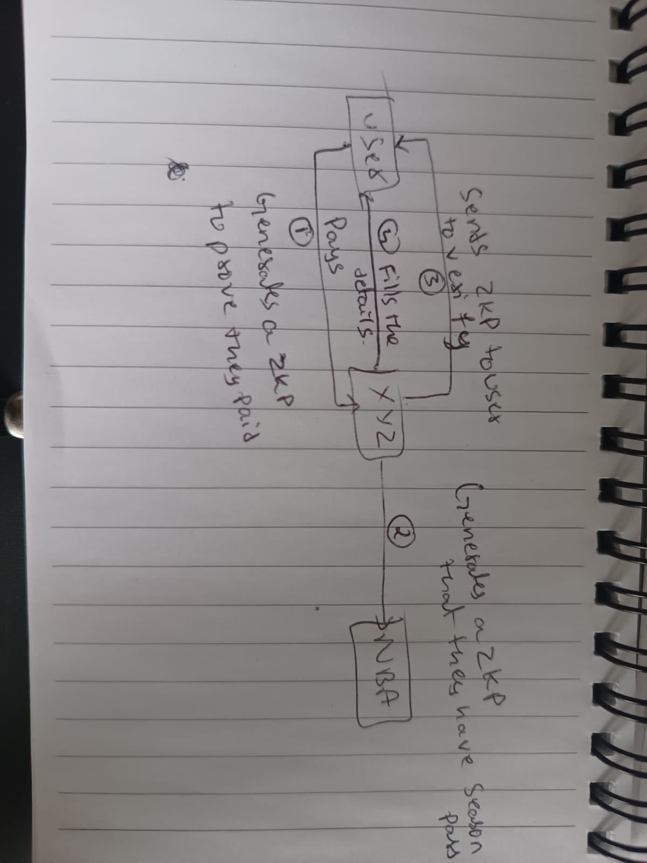

Slide 6
Thanks ;)

